Slide 1

EDA
Loan Dataset
Deepak Kumar

Slide 2
Exploratory Data Analysis Loan Prediction
Deepak Kumar

Slide 3
Loan Prediction Data Analytics
Objective:-
The goal of a loan dataset analysis to determine eligibility based on various factors to identify and analyze key attributes from the loan dataset, such as credit history, income, employment status, and other relevant factors, to establish criteria for assessing eligibility aiding in the accurate identification of individuals eligible for loans.

Slide 4
Introduction
In this comprehensive project focused on loan prediction analysis, our primary aim is to mitigate risks associated with loan approvals, streamline the decision-making process, and empower banking professionals with easy-to-use insights. Our approach involves leveraging a dataset containing detailed information about bank customers. We will thoroughly examine each column to uncover valuable patterns and insights, ultimately facilitating predictive loan status determination.
Chapter One serves as our introduction to the dataset. We'll delve into understanding its structure, including the number of columns, rows, and initiate the process of data cleansing. This involves meticulously addressing missing values, ensuring a robust and reliable dataset for our analysis.
Moving to Chapter Two, our focus shifts to segregating numerical and categorical columns. We'll conduct an in-depth analysis of categorical data by visualizing key aspects through bar graphs and pie charts. This graphical representation will aid in understanding the distribution and patterns within these columns.
Chapter Three involves a thorough exploration of numerical columns. Here, we'll derive statistical measures like mean, median, variance, and standard deviation. Additionally, we'll perform outlier analysis, visualizing data distribution using histograms and employing box plots to detect outliers. Furthermore, we'll normalize and standardize numerical columns for enhanced comparability.

Slide 5
Bivariate and multivariate analysis take center stage in Chapter Four. This phase allows us to explore correlations between variables, utilizing techniques like heatmap visualization to gain deeper insights into relationships within the dataset.
Chapter Five involves a pivotal step: transforming categorical columns into numerical ones. This transformation is crucial for subsequent modeling and analysis, enabling us to effectively utilize categorical data in predictive models.
Lastly, in Chapter Six, we'll synthesize the rich insights and patterns garnered from our analyses in the preceding chapters. This section will encapsulate the essence of our findings, paving the way for informed decision-making in loan approval processes.
Through a methodical and systematic approach across these chapters, we aim to revolutionize the loan approval landscape, empowering financial institutions with actionable insights to make informed decisions swiftly and accurately.

Slide 6
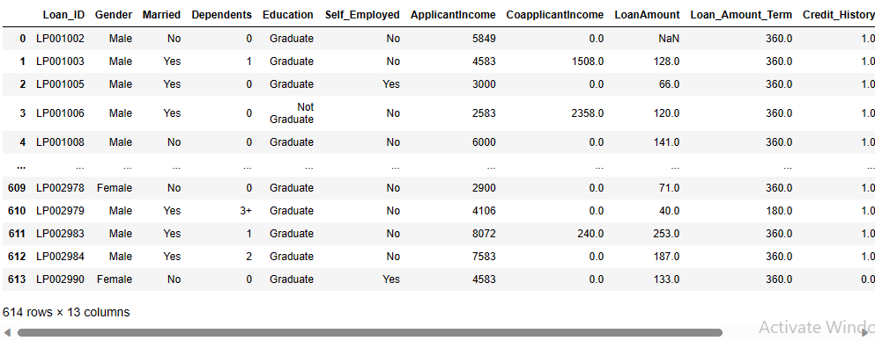
Basic Observation:-
Dataset:-
Figure:-1: Loan Dataset

Slide 7
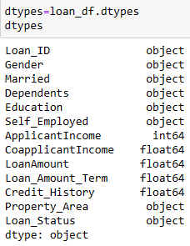
Data description:-
Shape:- There are total 614 rows and 13 columns in this dataset.
Size:- It gives the multiples of rows and columns of a dataset. The size of this dataset is 7982.
dtypes:- It gives information about the types of all the columns, which columns are object type and which are integer type.

Slide 8
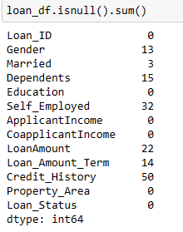
Isnull :- It gives the False at the place of null values.
Isnull().sum():- It provides the count of total null values in every columns.
From the above observation we conclude that the total counts of null values in every columns.
From the above observation we got outliers in the several columns. so, we are imputing median value in the missing values.
If the outliers is not present then we imputing with the mean values.
We impute the null values of the categorical column with mode values.
Figure:-2 :Total number of null values in every column

Slide 9
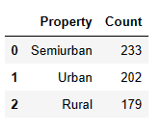

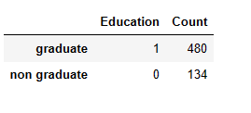
Categorical Data Analysis:-
Frequency tables:-
From the first frequency table we conclude that the how many loan applicant members lives in semiurban , urban and rural area.
From the second frequency table we conclude that the how many loan applicant members are males and females.
From the third frequency table we conclude that the how many loan applicant are graduate and non graduate.
Figure :- 3 frequency table of property
Figure:-5 : frequency able of Education
Figure:- 4 : frequency table of gender

Slide 10
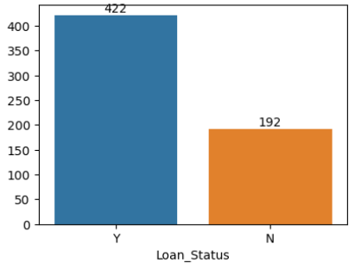
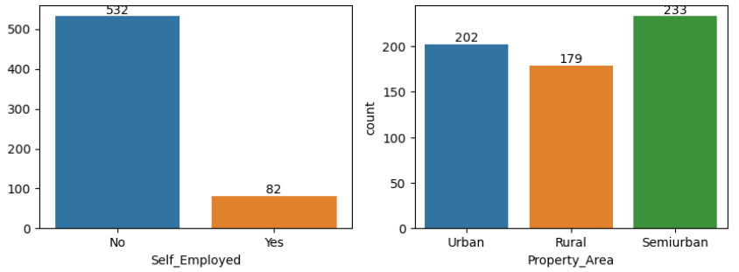
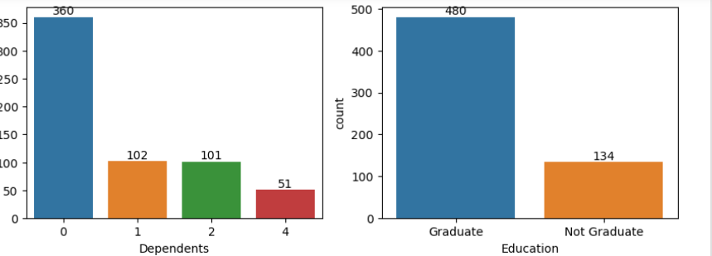
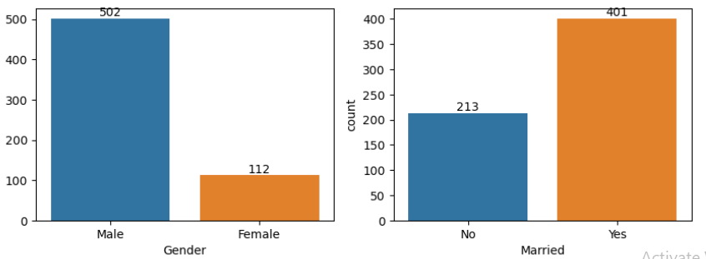
Bar Chart:-
In Bar Chart One axis is numerical And the other axis is categorical .X axis is categorical and Y axis is Numerical.
From the above bar chart we conclude all the categorical columns with their unique values and count i.e. Which columns have how many unique value and what are the counts of their unique values.

Slide 11
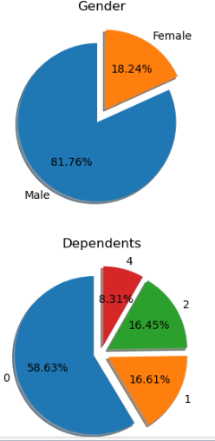
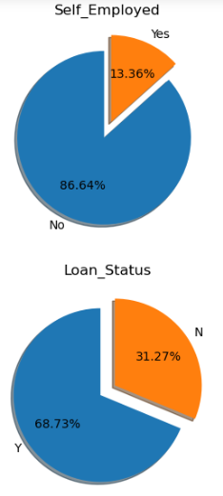
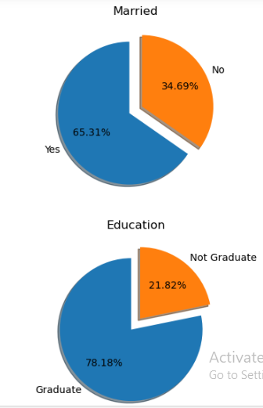
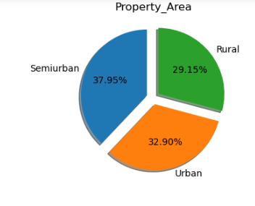
Pie Chart:- From the above Pie chart we conclude that every categorical column with relative frequency of their unique values. From married Column we conclude that 65.31% of loan applicant are married and 34.69% are unmarried. From Gender column we conclude that 81.76% of loan applicant are male and 18.24% are Female. From Self Employed column 86.64% of loan applicant are self employed and 13.36% are not self employed. From property area column we conclude that 37.95% of total loan applicant are live in semiurban , 32.90% are lives in urban and 29.15% are lives in rural area. From education we conclude that 78.18% are graduate and 21.82% are not graduate. From Loan status we conclude that 68.73% of loan applicant lone are approved and 31.27 % applicant loan are not approved.

Slide 12
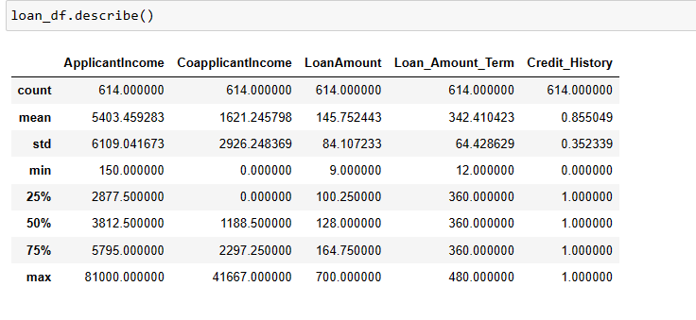
Numerical Data Analysis:- From the above describe function we Know the all the statsticals values of all the Numerical Columns. Like We know about the Mean ,Median ,Count , Standard deviation, Q1(25%),Q2(50%),Q3(75%) and Max values of all the columns. By this observation we can easily draw the Histogram of all the Numerical Columns.

Slide 13
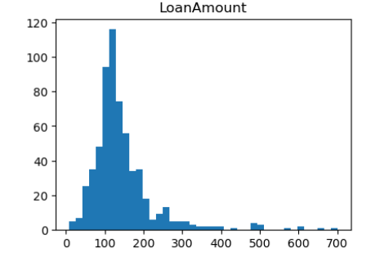
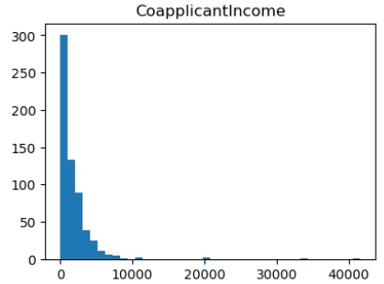
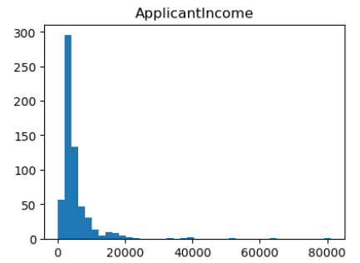
Histogram:- From the first histogram we conclude that the loan amount is right skewed .The most of the loan amount that is applied for the loan by the applicant is in between 100k to 200k rupees and the highest applicant count is 120. From the second histogram we conclude that the Co-applicant income is right skewed . The most of the co-applicant income is lie between 0 to 10000 rupees and the highest count of the co-applicant is 300. From the third histogram we conclude that the Applicant income is right skewed .The most of the Applicant income is in between 0 to 20000 rupees and the highest count of the Applicant is 300.

Slide 14
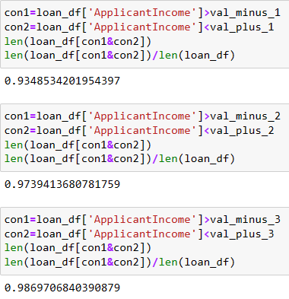
Empirical Rule:-
We know that the Empirical rule based on 68–95–99.7 rule
From the above observation we conclude that this dataset is not follow the empirical rule condition 68–95–99.7 that’s why we conclude that the above dataset is not normally distributed.
So, first we convert this dataset in normal distributed form and then we analyze this Dataset.

Slide 15
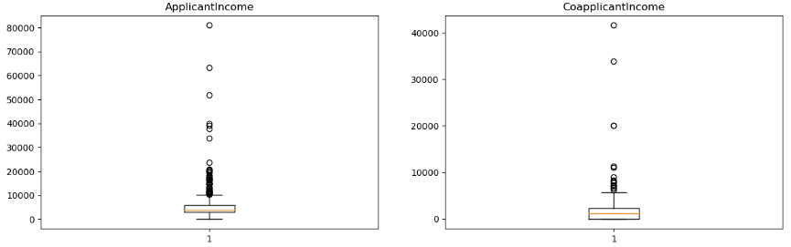
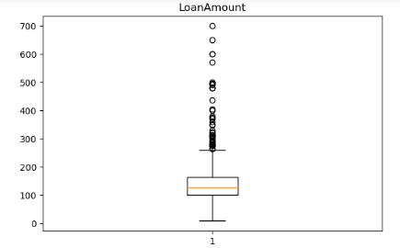
Outliers Analysis:-
Boxplot:-
We draw boxplot of the numerical columns, To know the Outliers are present or not in the dataset.
From the above boxplot of the Applicant Income, co-applicant Income and Loan amount column we conclude that
Applicant Income have total 8% of outliers present in the data.
Co-applicant Income have total approx. 3% of outliers present in the data.
Loan Amount have total 6.67% of outliers present in the data.

Slide 16
From the boxplot we had seen lot of outliers are present in the dataset. So, we have to remove the outliers from the above dataset.
There are so many methods are used to remove the outliers from the columns.
First we calculate the outliers from all the columns.
Then remove the outliers from all the columns.
Then we impute with the median values by the way we can easily deals with the outliers.
After imputing the values we get extra columns . So, we take new columns and drop the old columns which have outliers.

Slide 17
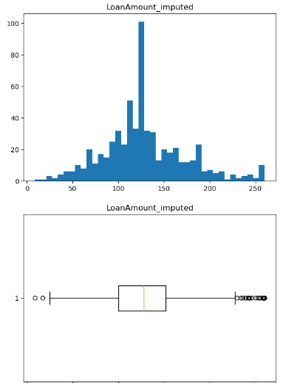
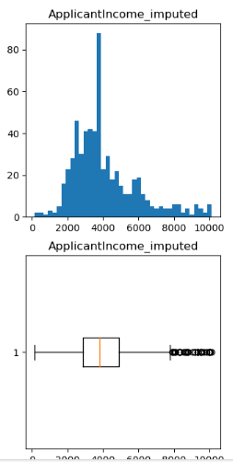
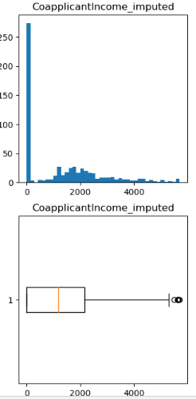
Boxplot and Histogram after imputed with Median Values:-
After removing the outliers we plot the boxplot of all the columns and Histogram to check the outliers are removed or not.
After removing the outliers, we can see the histogram it look like a normal distribution and when we observe the boxplot diagram so many outliers are removed .

Slide 18
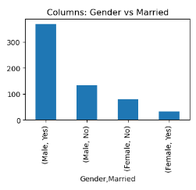
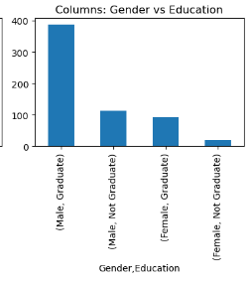
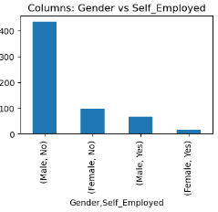
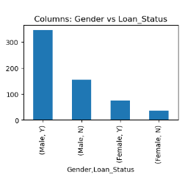
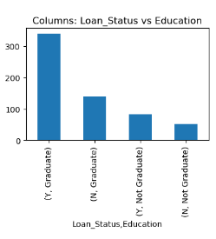
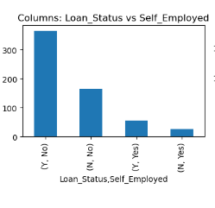
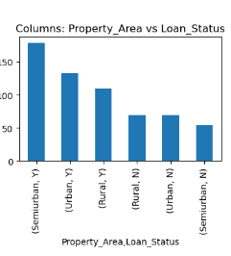
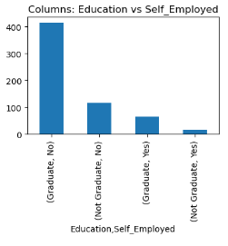
Bi-variate Analysis:-
Bivariate analysis is an analysis of two variables to determine the relationships between them. They are often reported in quality of life research. It is one of the simplest forms of quantitative (statistical) analysis..

Slide 19
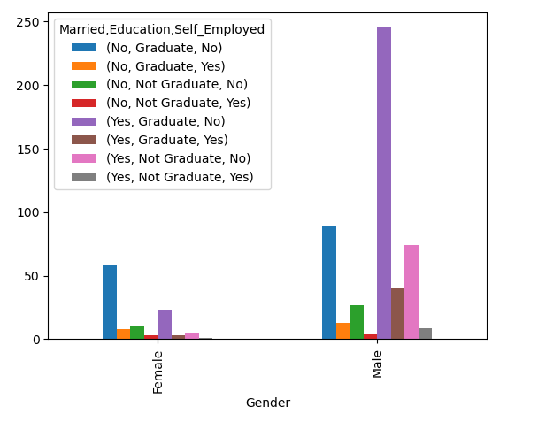
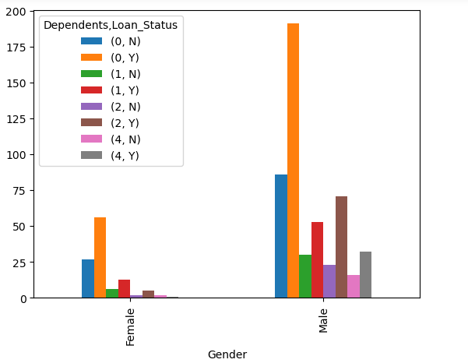
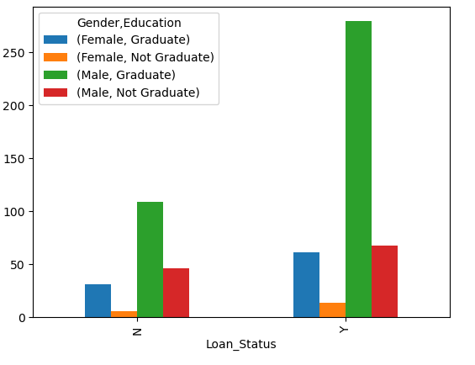
Multivariate Analysis:-
Multivariate analysis is a statistical technique used to analyze data involving multiple variables simultaneously to understand the relationships between them. When dealing with loan data prediction, multivariate analysis is a powerful tool to identify patterns, correlations, and factors that influence loan approvals, defaults, or other related outcomes
From the above chart we find the relation between one column to the other different columns.
From first we conclude that in gender how many males and females are graduate or not graduate from the education column , then how many males and females are self employed and how many are not employed.
From the second chart we conclude the loan status of the males and females from the loan status column and number of dependents from the dependents column.
From third chart we find the relation between loan status , Gender, education .

Slide 20
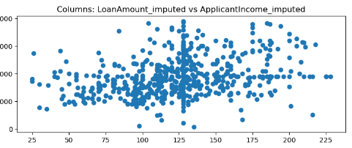
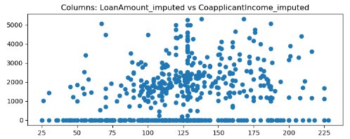
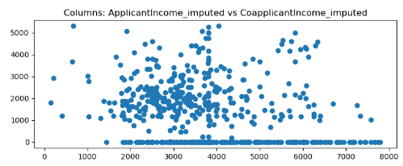
Scatter Plot:-
A scatter plot is a graphical representation of data points in a 2 dimensional space , where each point represents the values of two variables . It identified patterns trends or outliers of the data making it easier to understand the nature of relationship between variables.
From the above diagram we can say that there is no certain relationship between loan amount and applicant income . Because applicant income increases the loan amount also increases.
From the above diagram we can say that there is no certain relationship between loan amount and coapplicant income and loan amount. Because co-applicant income increases the loan amount also increases.
From the above diagram we can say that there is no certain relationship between co-applicant income and applicant income .
Correlation:- it quantifies the strength and direction of a linear relationship between two sets of data. The correlation coefficient, often denoted by "r," ranges from -1 to 1.

Slide 21
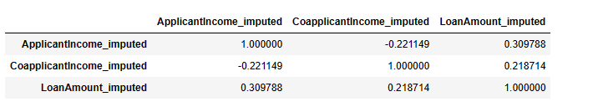
Covariance matrix:-
From the above covariance matrix we see the relation between co applicant income imputed and applicant income imputed has negative relation between them.
From the above covariance matrix we see the relation between co applicant income and loan amount imputed has negative relation between them.
From the above covariance matrix we see the relation between loan amount imputed and applicant income imputed has positive relation between them.
From the above covariance matrix we see the relation between co applicant income imputed and loan amount imputed has negative relation between them.

Slide 22
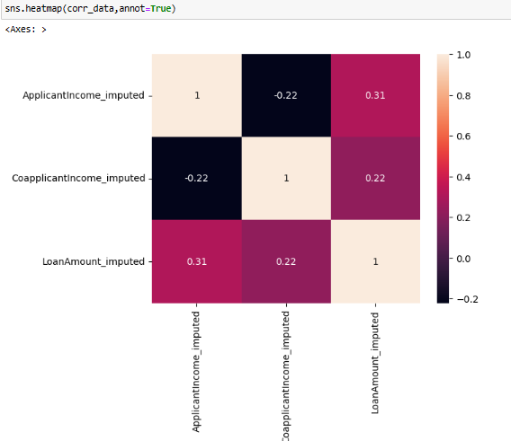
Heat map of numerical column:-
A Visual Representation of Data .It Uses color to represent values in a matrix. It is Ideal for displaying the intensity of data at the intersection of two numerical variables . Structure of a heatmap is in matrix form.

Slide 23
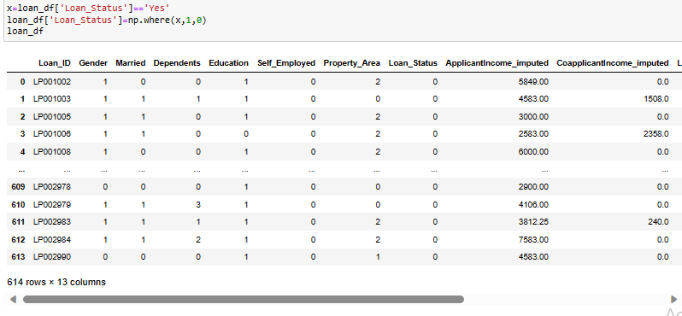
converting Categorical to Numerical:-
Converting Categorical columns to numerical columns is very important task as when we train the machine learning model it does not understand the categorical column values so we should convert the categorical columns into the numerical columns.
We can convert categorical to numerical by following ways
1)using the Map
2)using np.where( ) [binary conditions only]
3) LabelEncoder
4)one hot encoder we can use pd.get_dummies() method

Slide 24
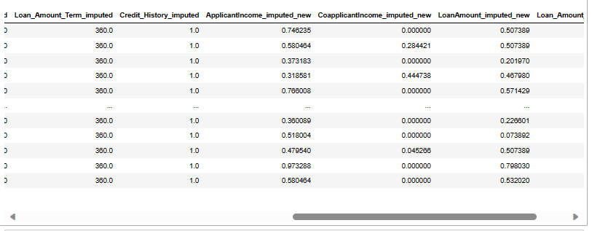
Normalization and Standardization:-
In every dataset we have different columns have different units.
In every dataset we have different columns has values varies from -∞ to ∞.
It is very important to standardized the data make sure all the columns values under the same range .
To achieve this we have two methods
Normalization
Standardization

Slide 25
Insights/Patterns:-
The most of the males who are married which around 42.99% percentile whose loan status are approved.
Male and Female who are graduate are 55.3%.They have high chances to approved their loan status in comparison with non graduate loan applicant members.
Approximately 39.07% of males who are married and graduated ,their loan status are approved.
Graduated members from semi-urban who don’t have self employment nearly 20.035% has approved the loan status.
From semi-urban area the male applicants who were not self-Employed but applicants are graduated nearly 15.14% has approved the loan status.
The correlation between the applicants income and loan amount is very high which is approx. 0.57% relation among them.

Slide 26
Conclusion:-
The approval of loan to the applicants is very important.
Approval of loan to the applicants is very important aspect in the bank sector based on the various aspects that we need to check like the applicants income and personal details like gender married status education details and check the other details like self-employed or not .we have performed our analysis on various columns and we made the insights. we found majority of loan approvals are based on our analysis like we have performed numerical and categorical analysis on the columns and we draw various graphs like bar and pie and histograms sample data.
After a deep analysis we made the insights based on our analysis and we concluded that majority of loan approvals based on our insights.

Slide 27
THANK
YOU

